Slide 1
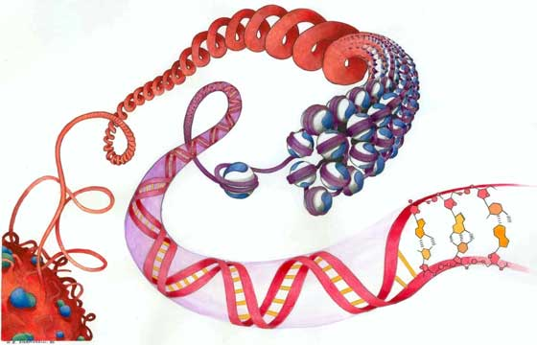

Pairwise sequence alignment
Jiankui He
SUSTC, Shenzhen, China
Image by Nicolas Bouvier; courtesy of Genevieve Almouzni, Curie Institute, Paris, France
PPT adopted from John Hopkins University

Slide 2
Schedule
Class I: lecture
Class II: homework, programming
Class III: Demo

Slide 3
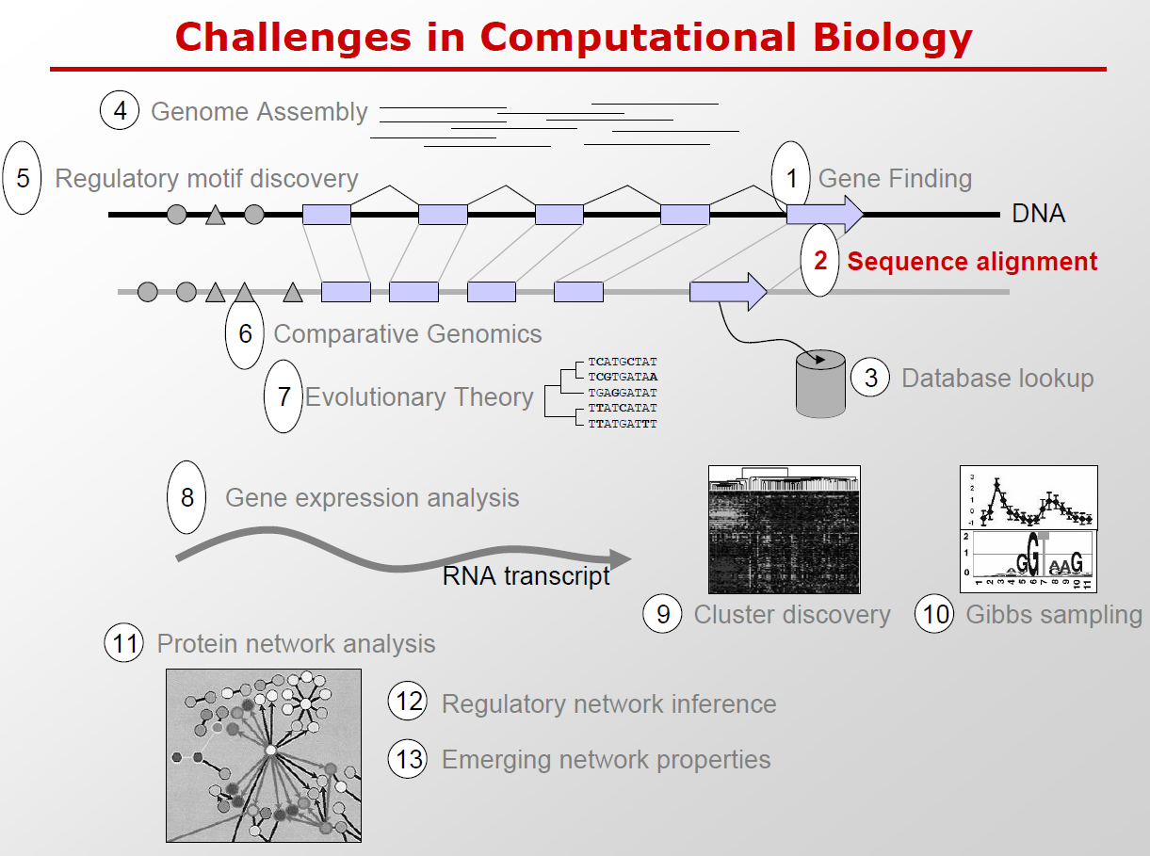

Slide 4
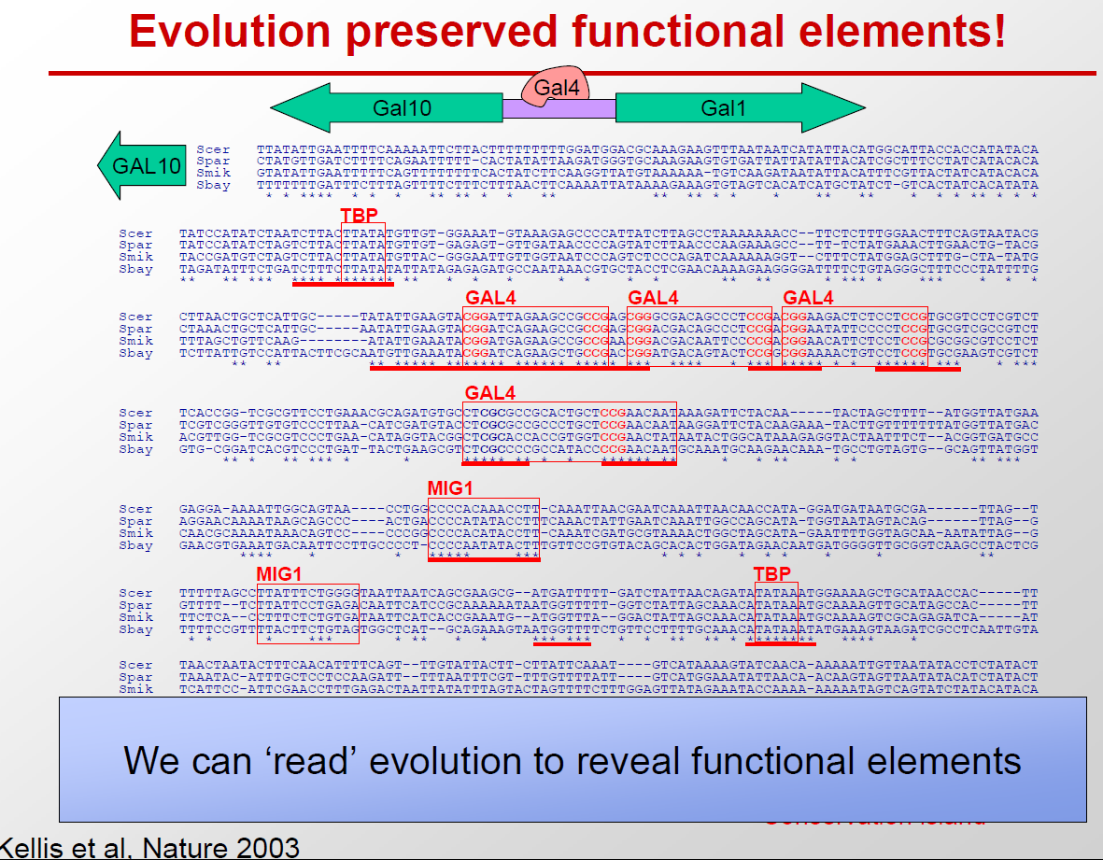

Slide 5
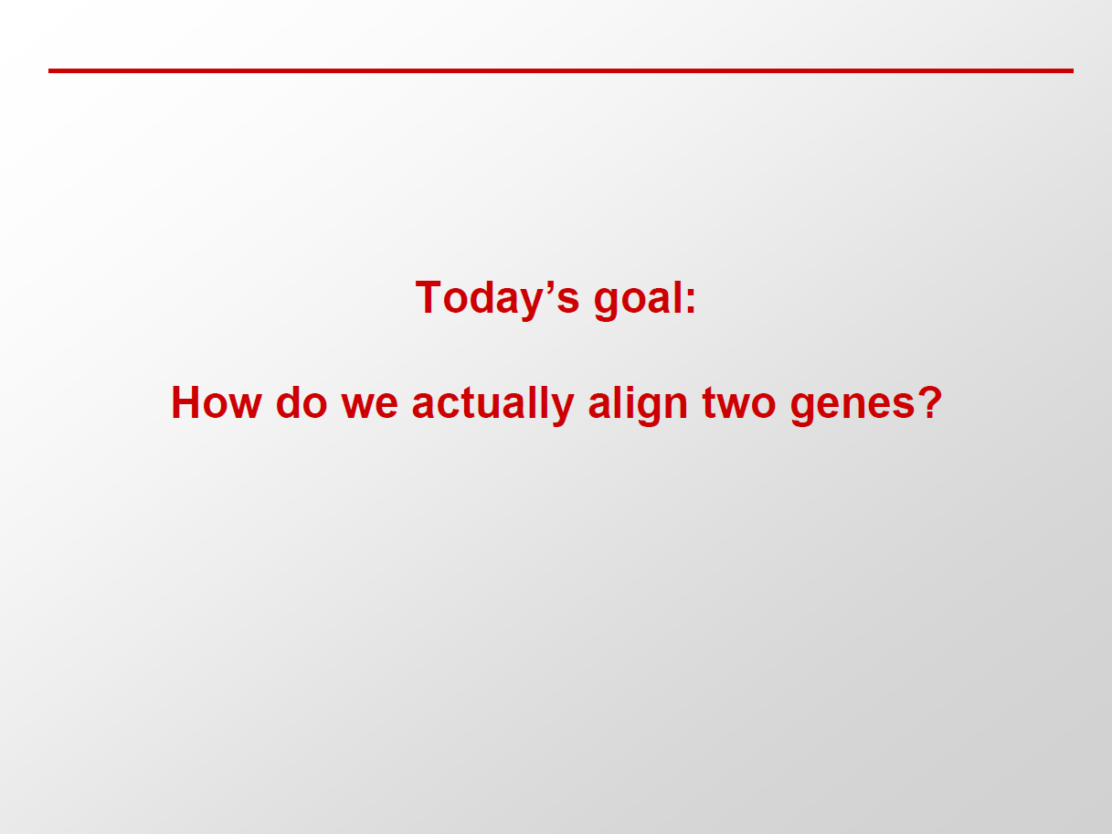

Slide 6
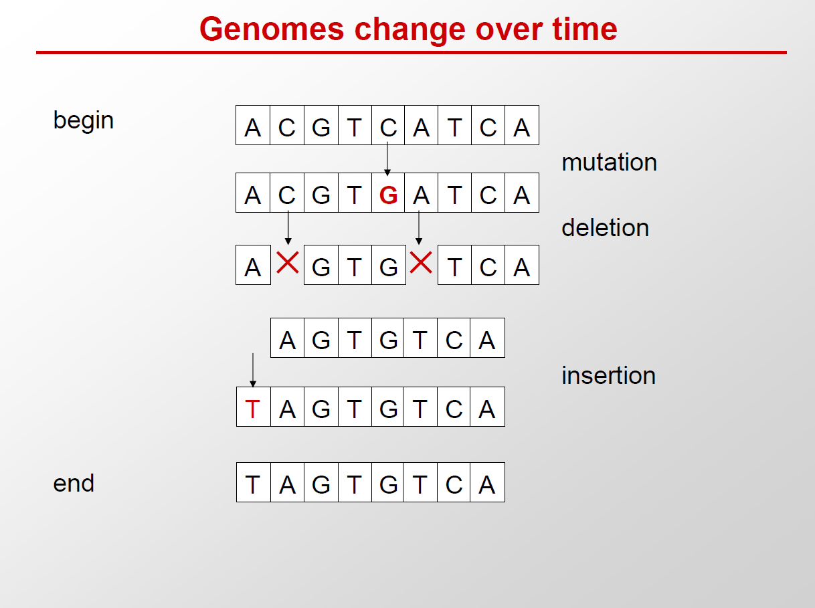
Notes:
Time machine

Slide 7
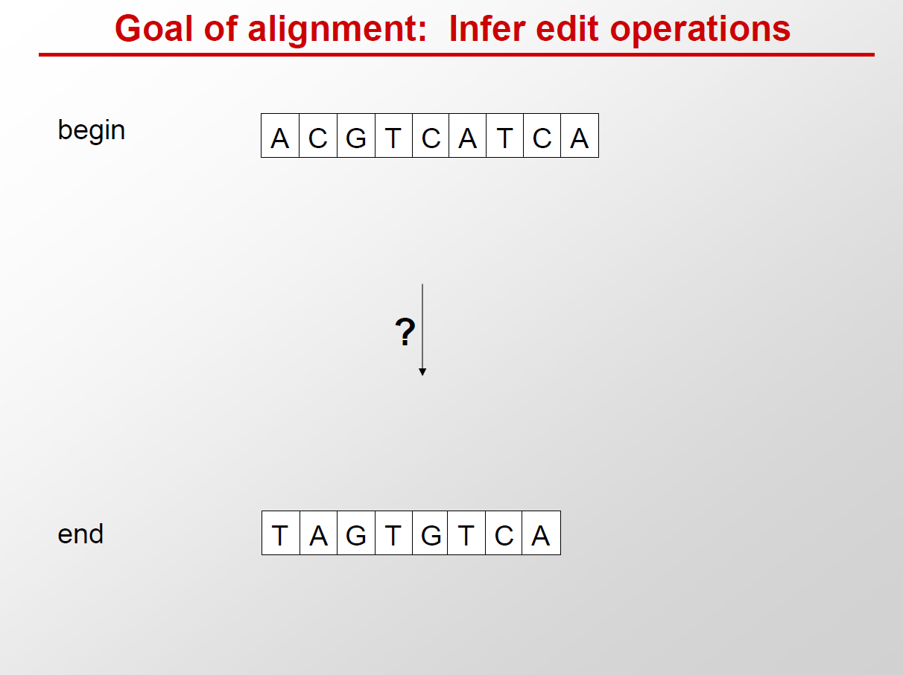

Slide 8
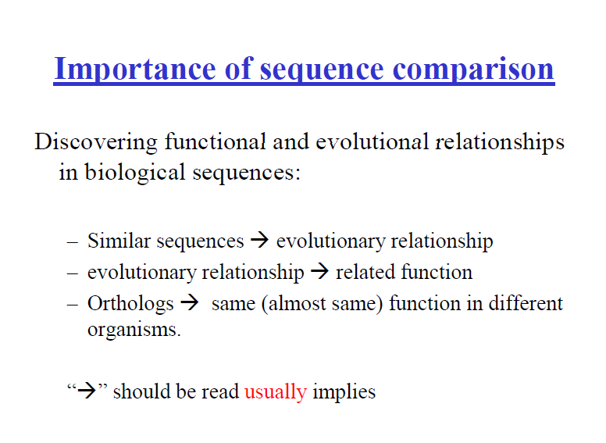

Slide 9
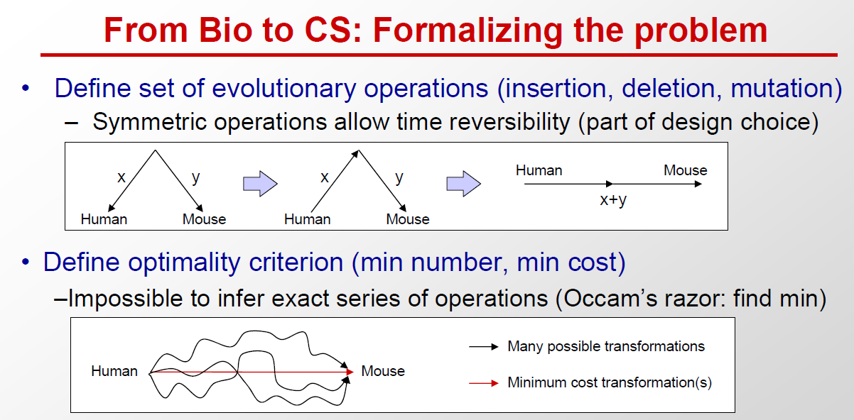

Slide 10
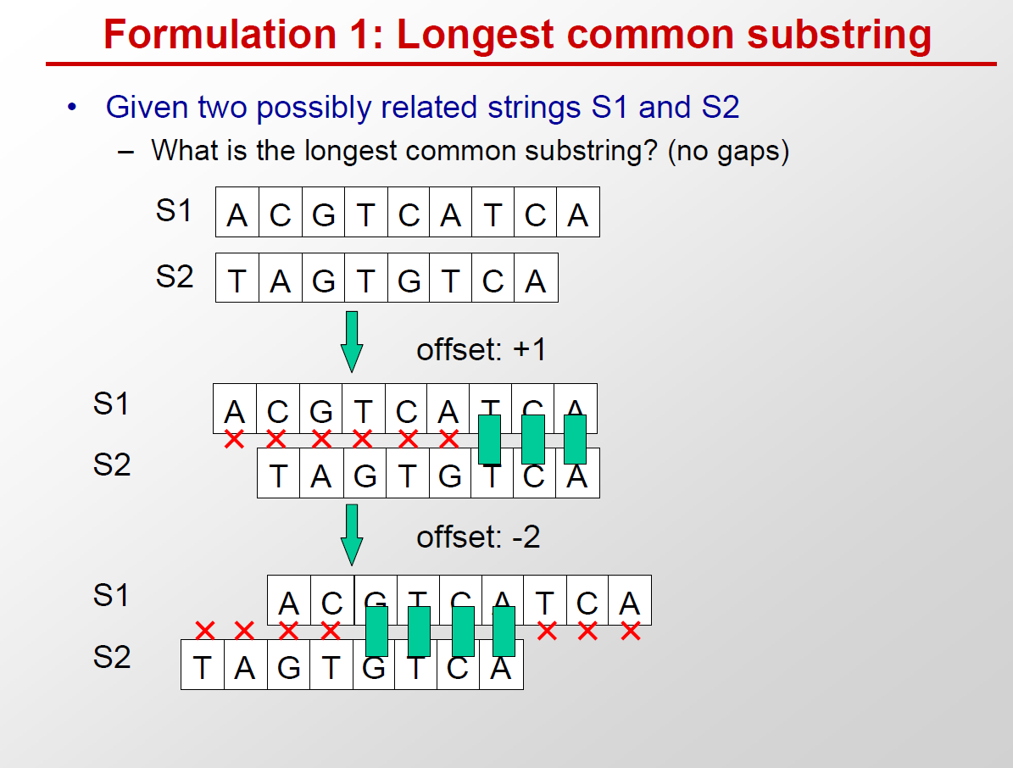

Slide 11
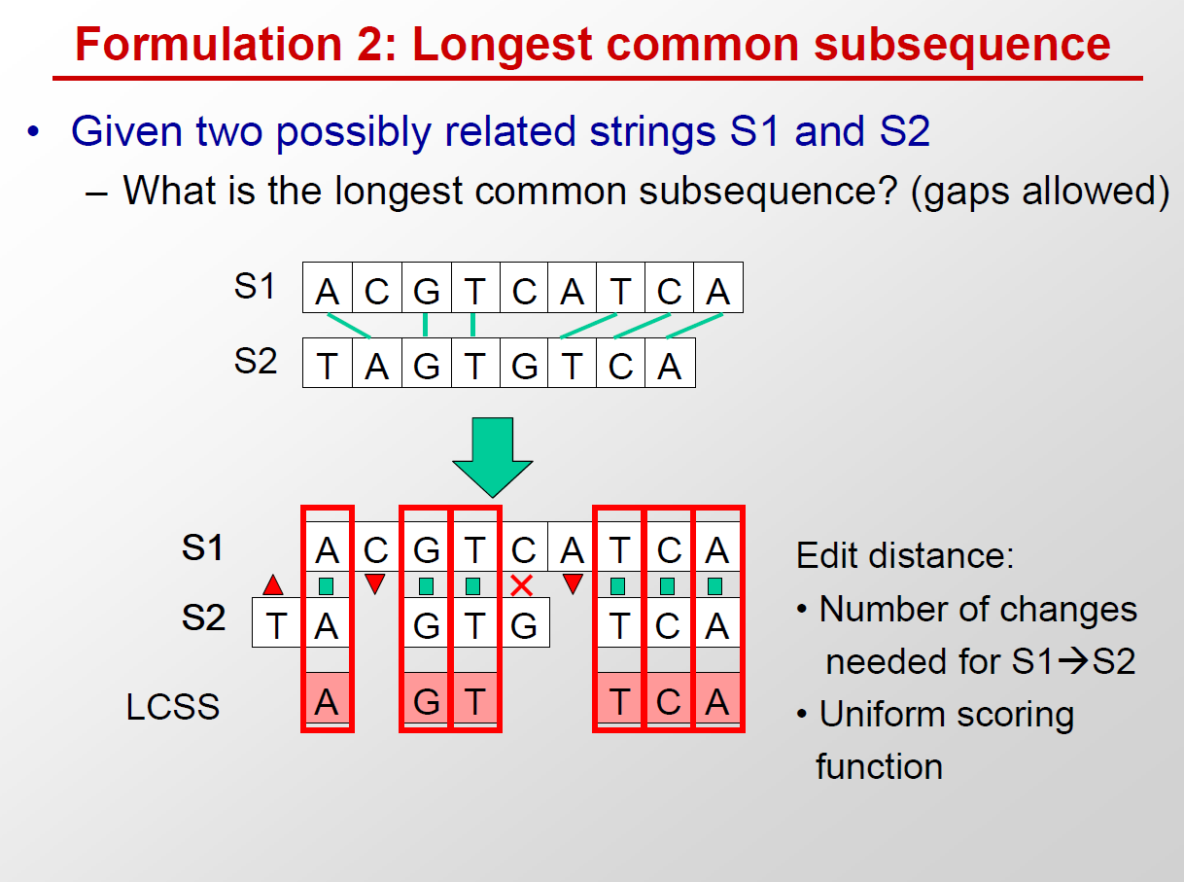

Slide 12
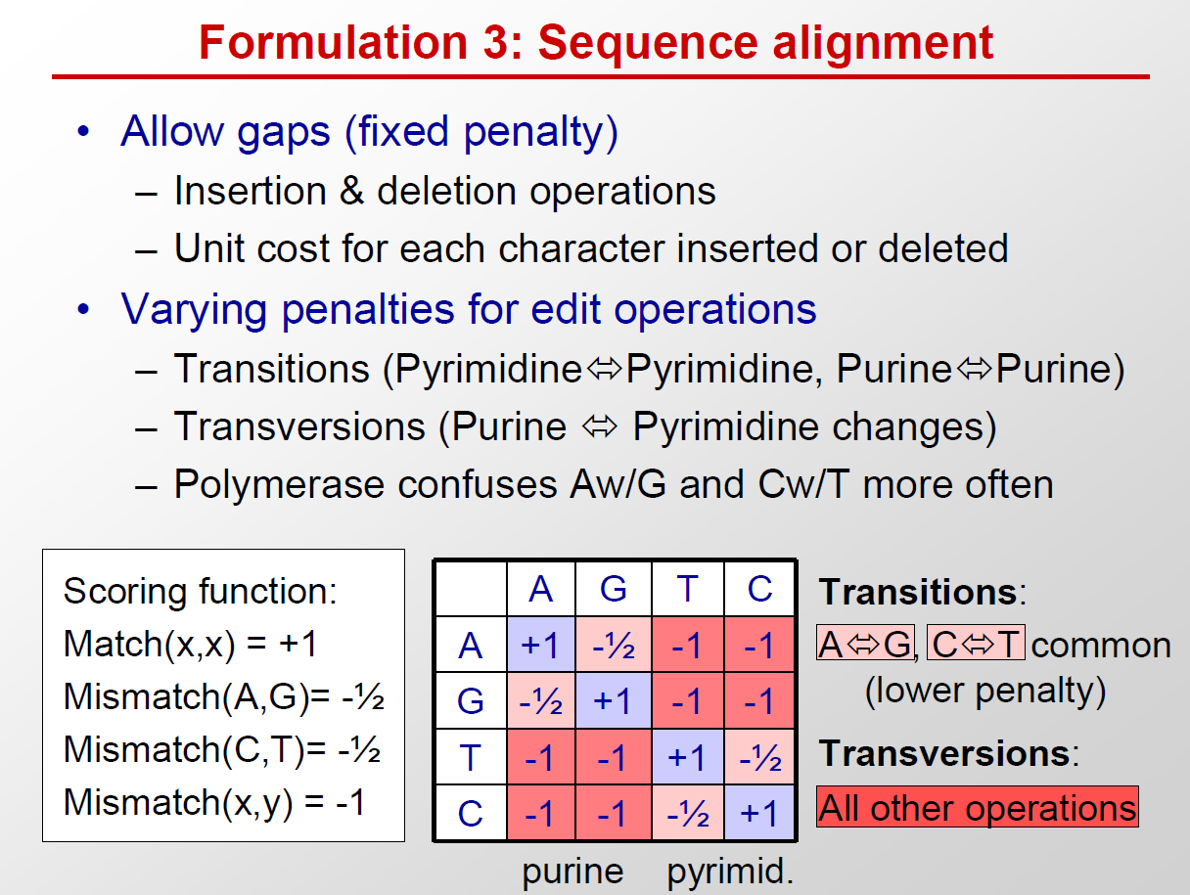

Slide 13
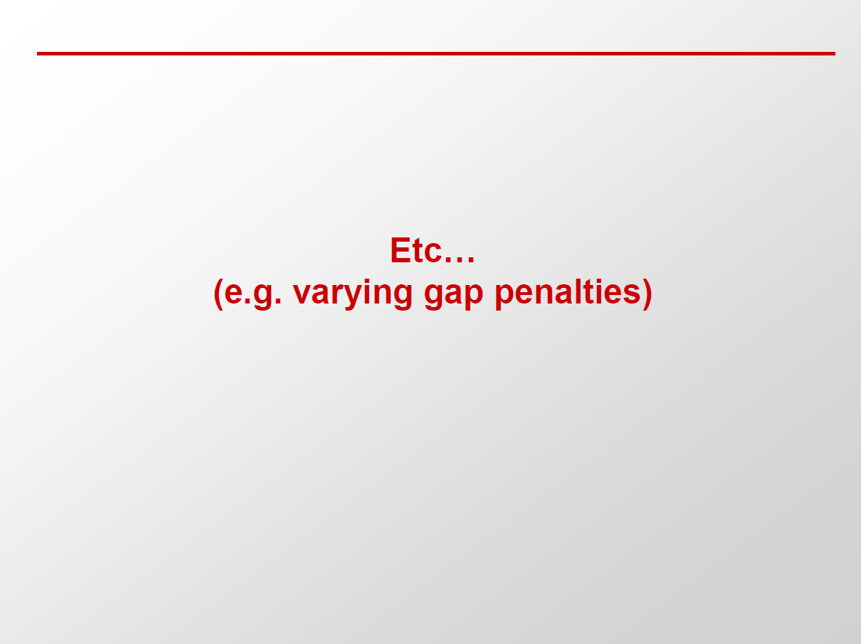

Slide 14
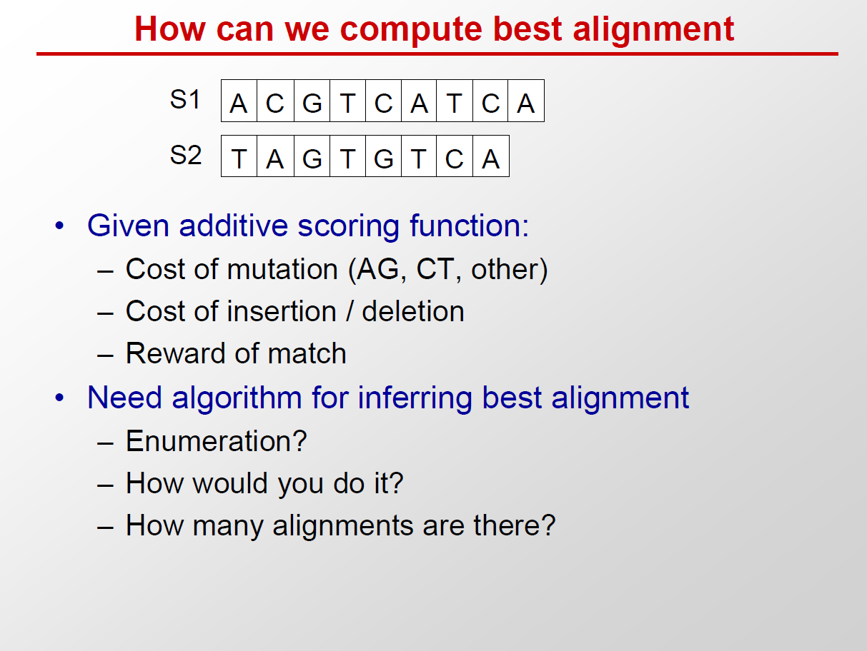

Slide 15
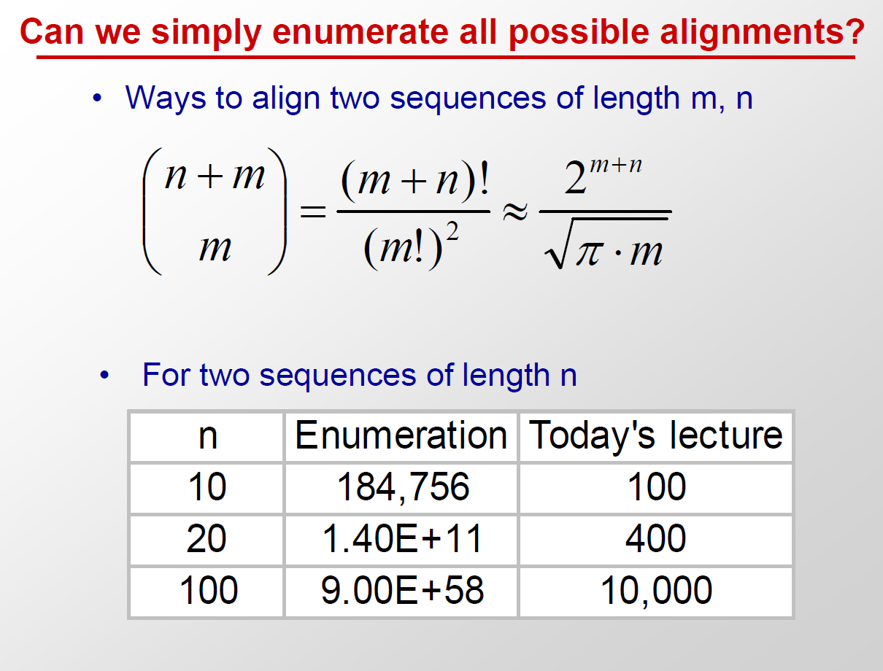

Slide 16
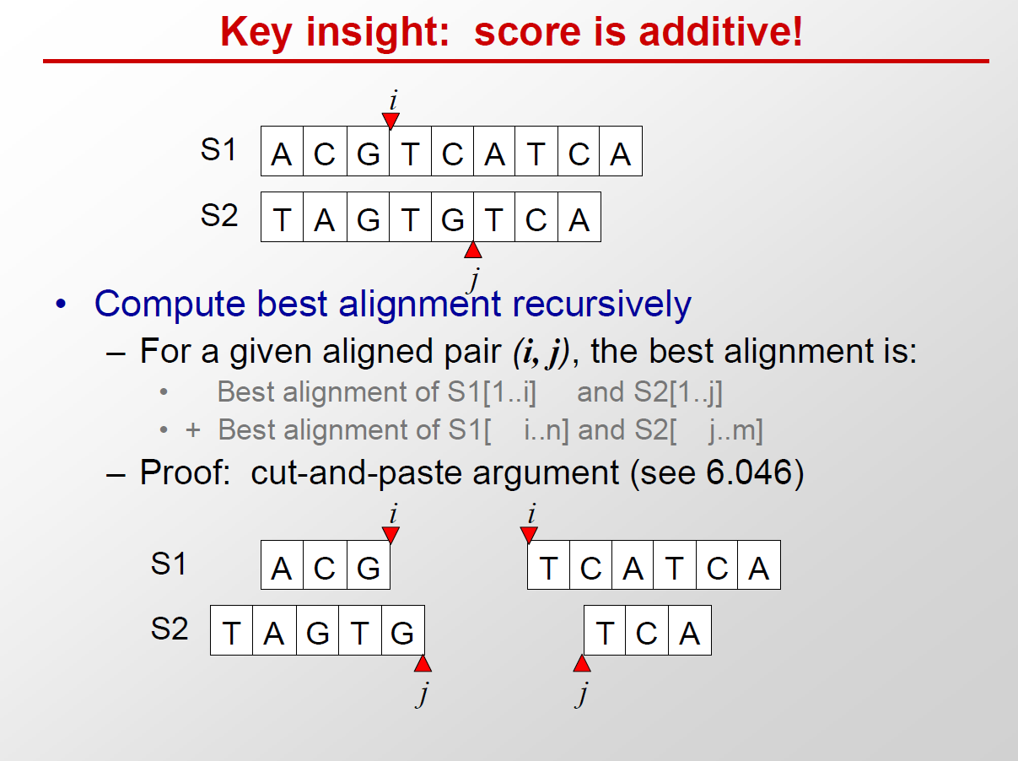

Slide 17
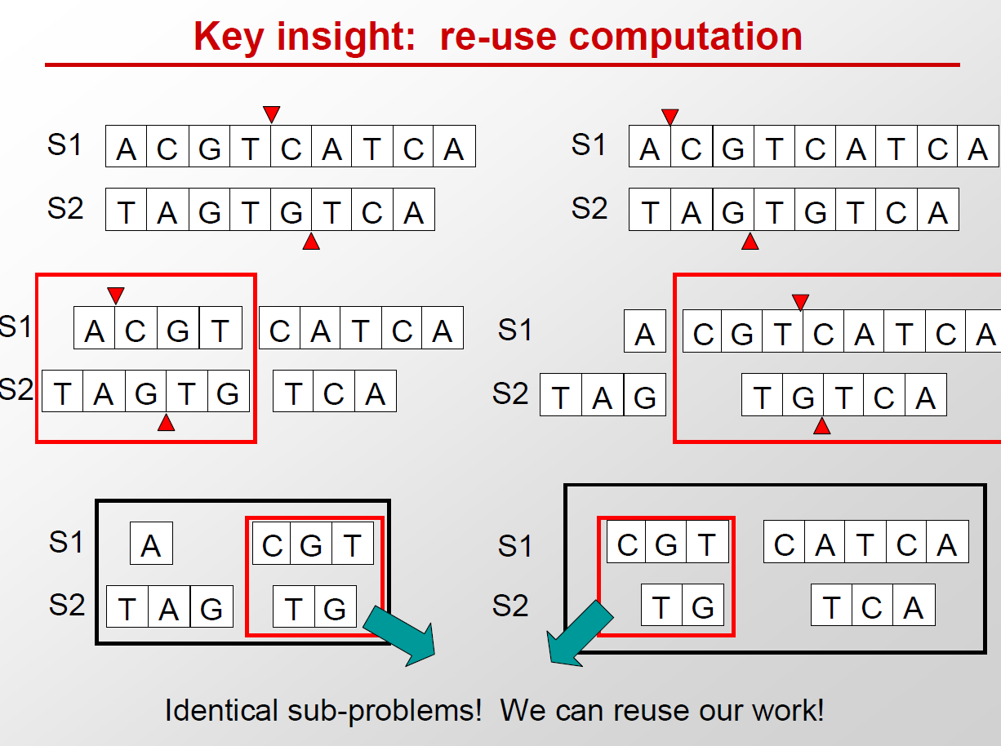

Slide 18
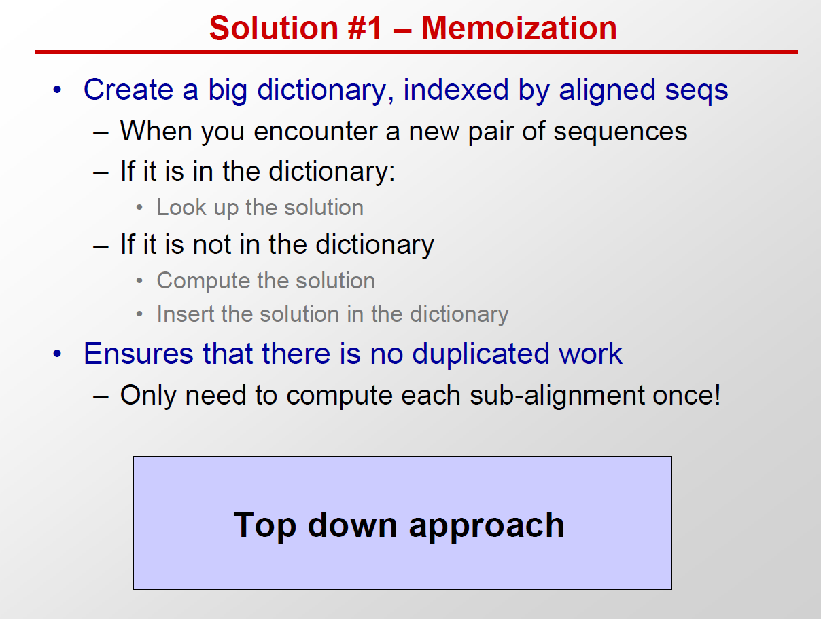

Slide 19
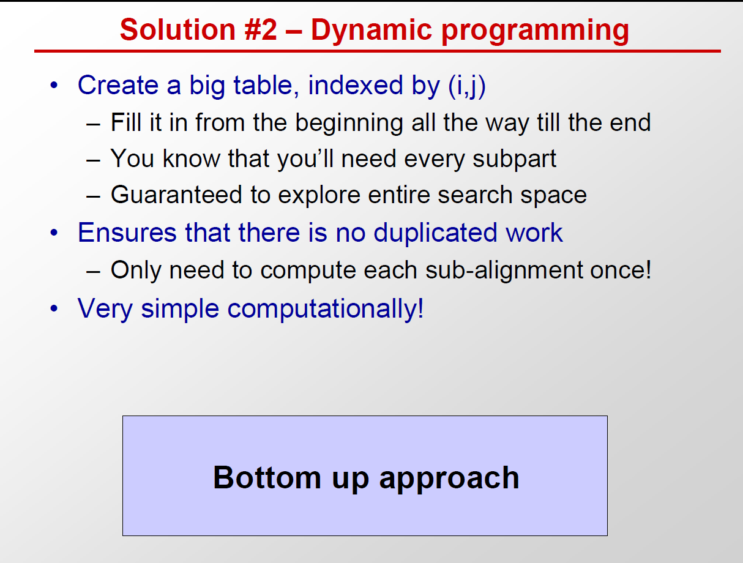

Slide 20
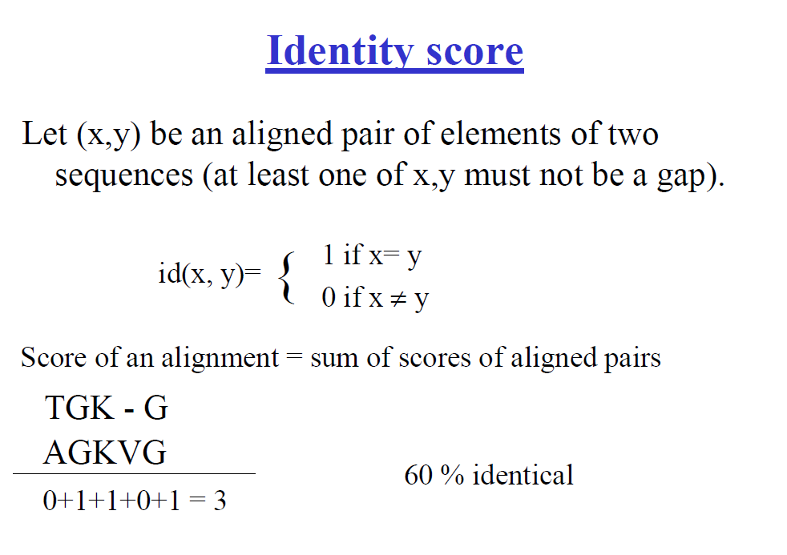
Identity score =number of matched elements / length of alignment

Slide 21
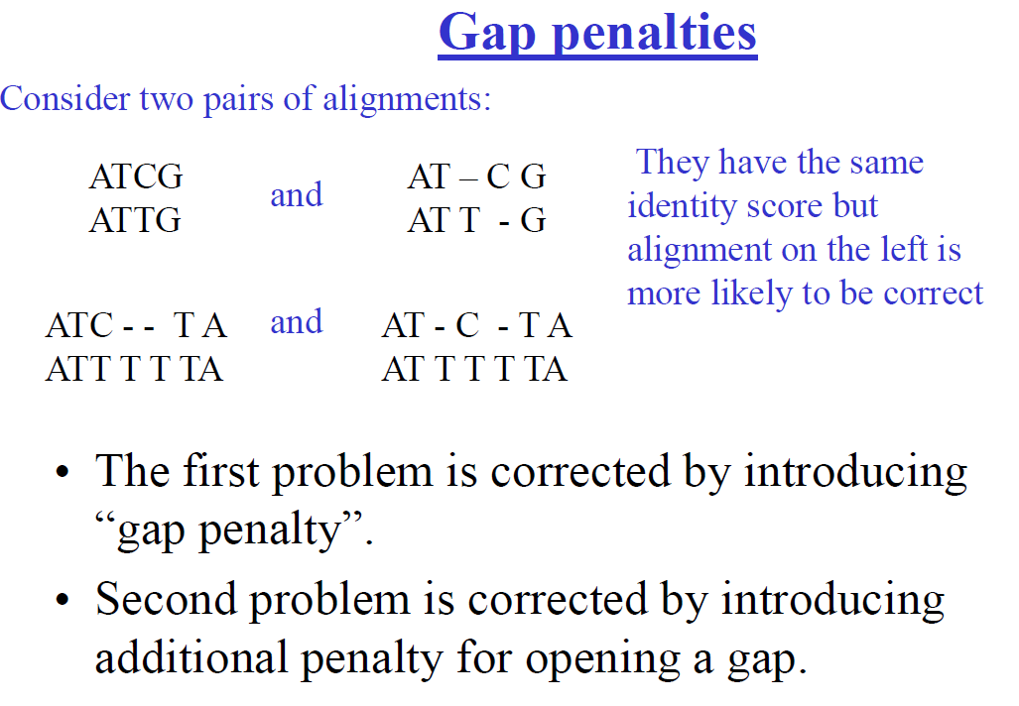

Slide 22
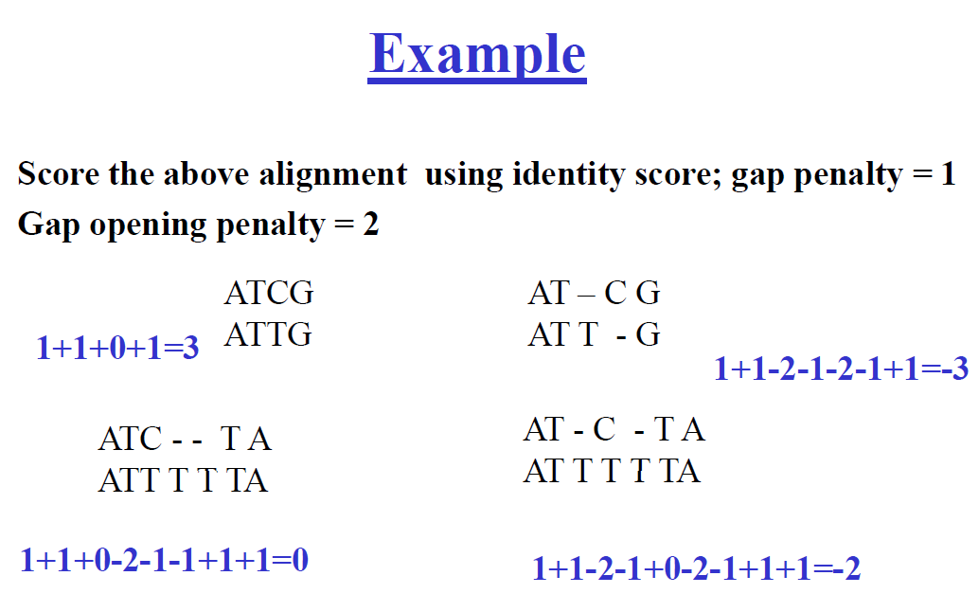

Slide 23
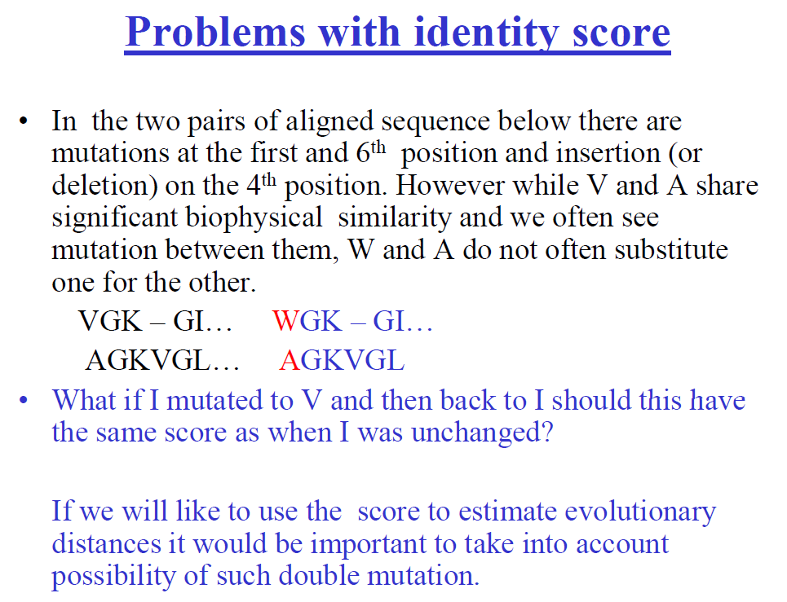

Slide 24
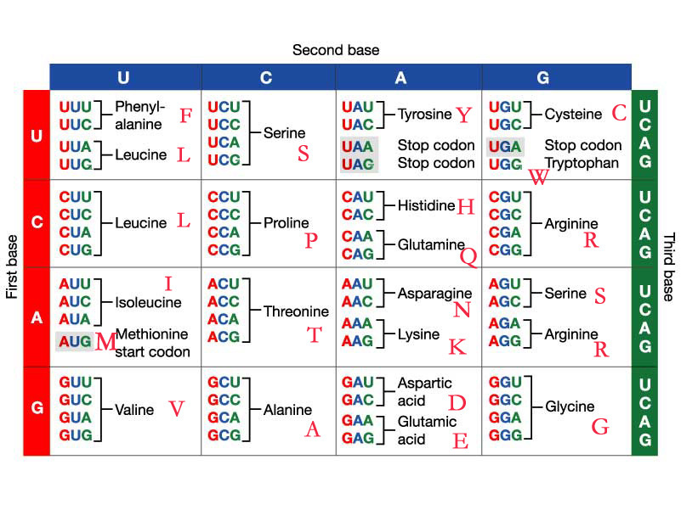

Slide 25
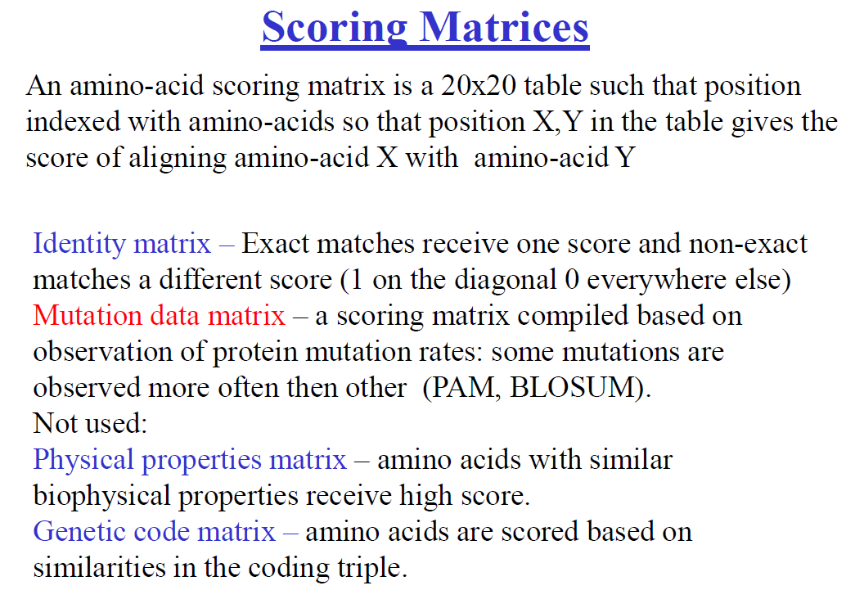

Slide 26
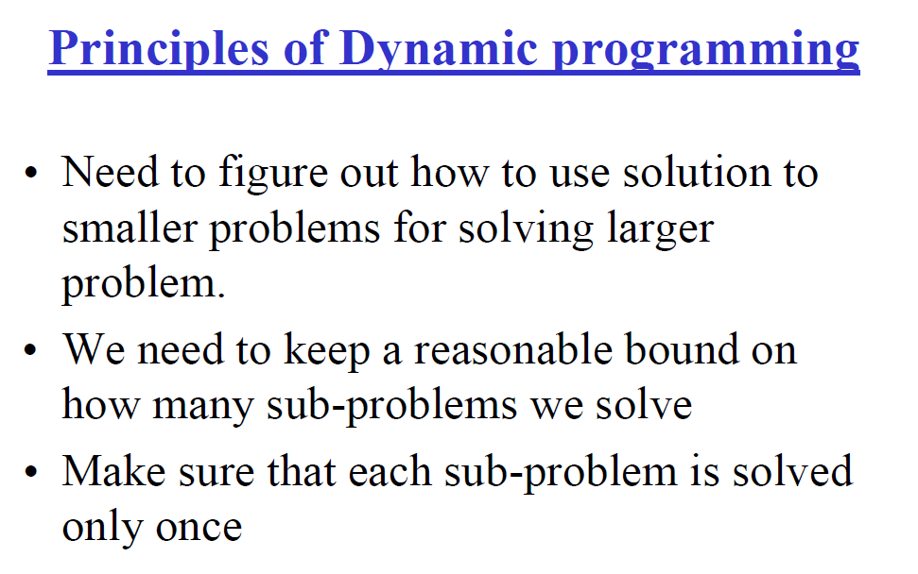

Slide 27
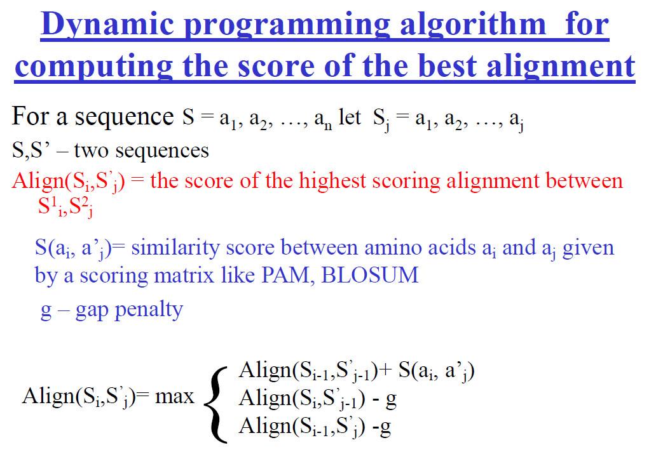

Slide 28
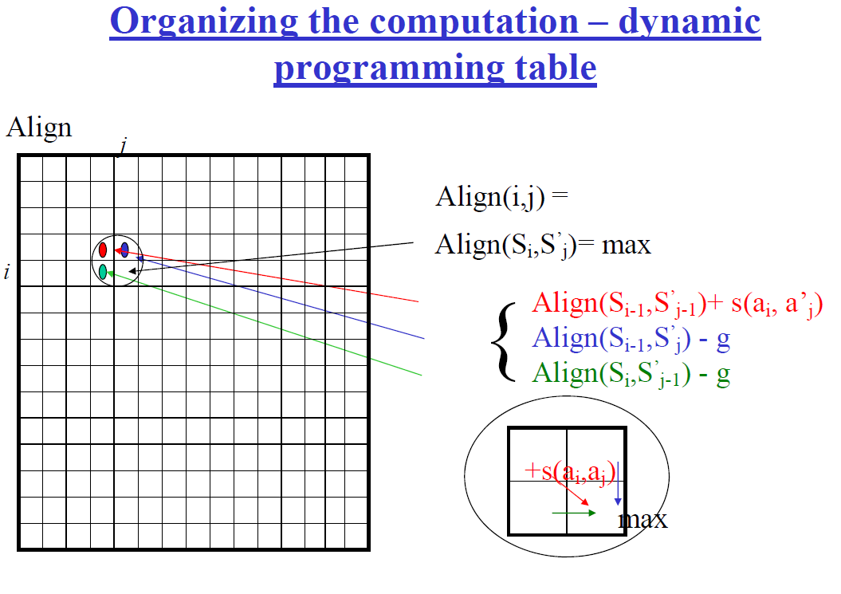

Slide 29
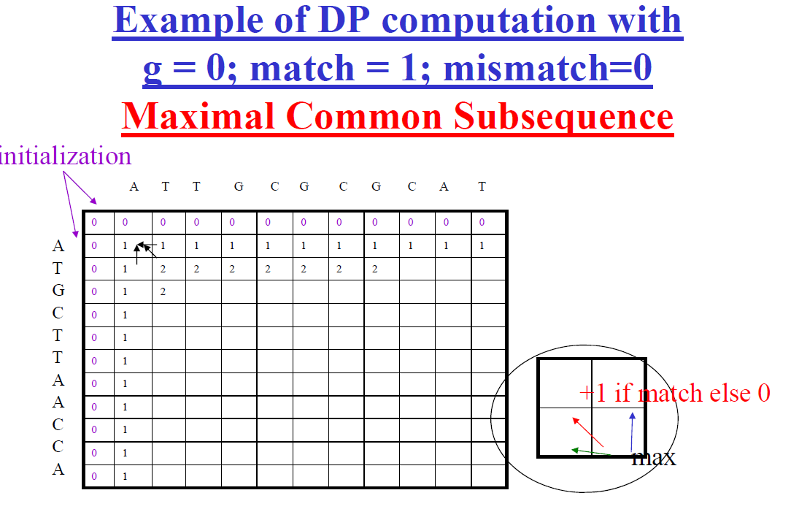

Slide 30
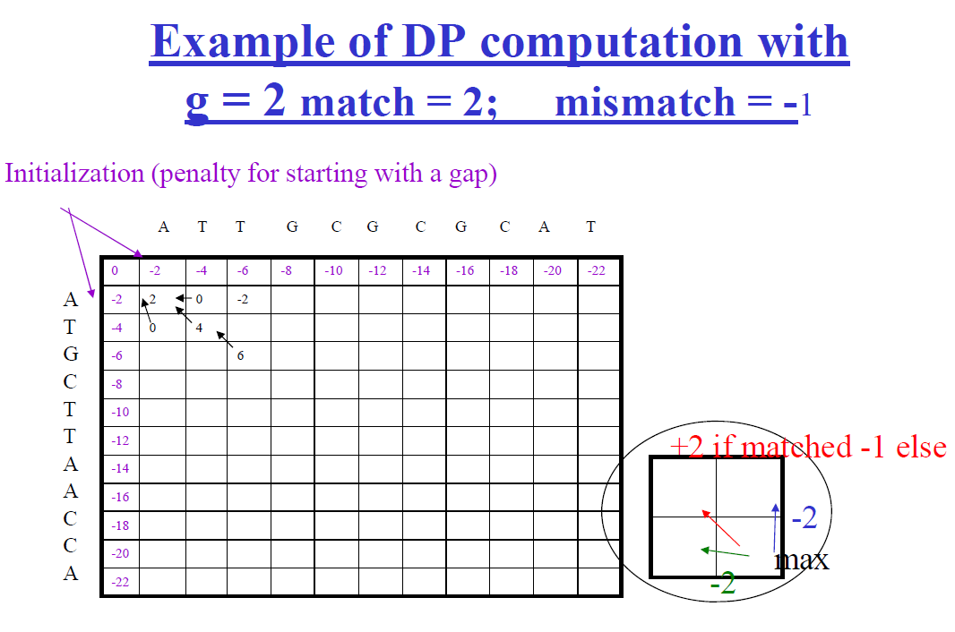

Slide 31
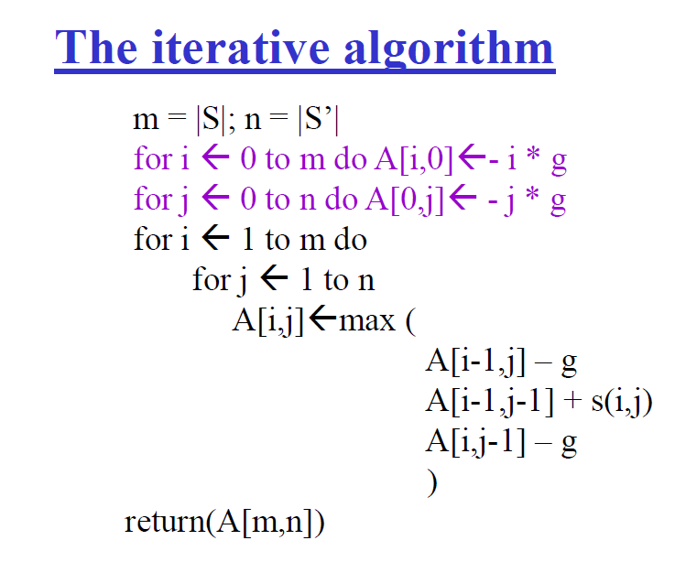

Slide 32
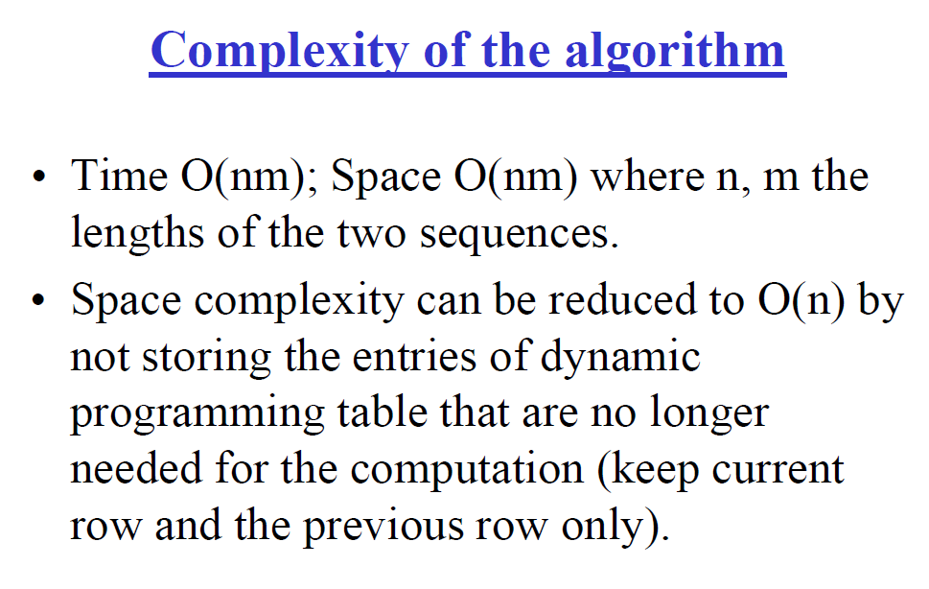

Slide 33
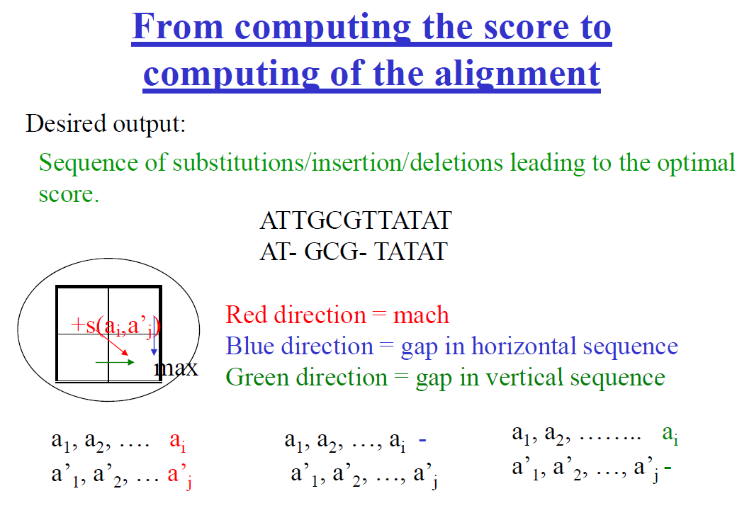

Slide 34
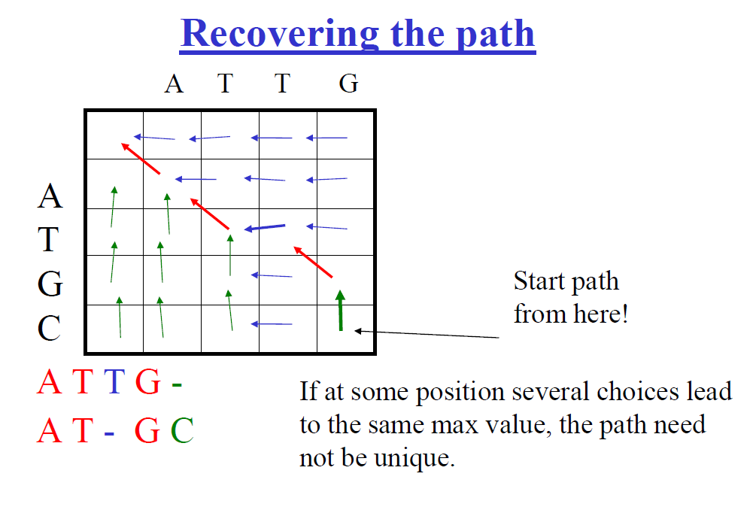

Slide 35
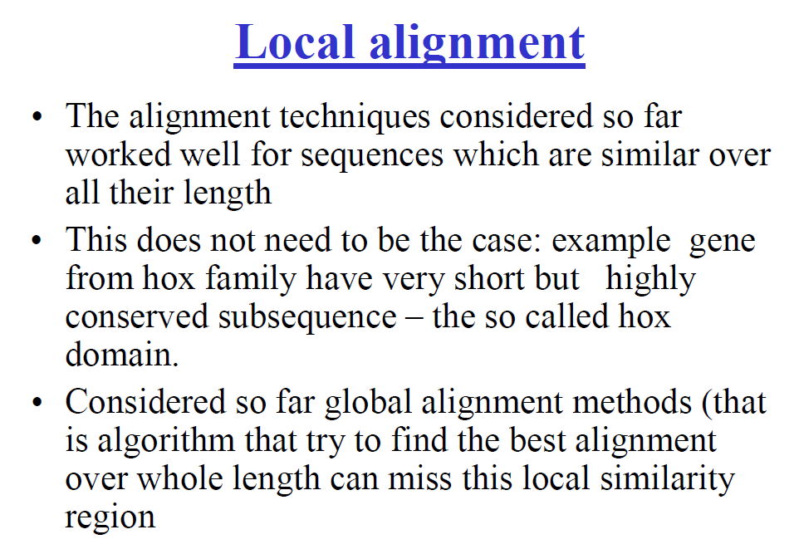

Slide 36
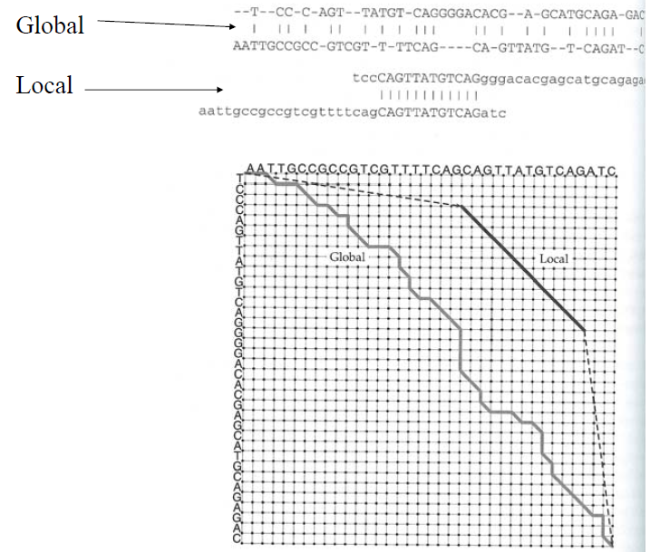

Slide 37
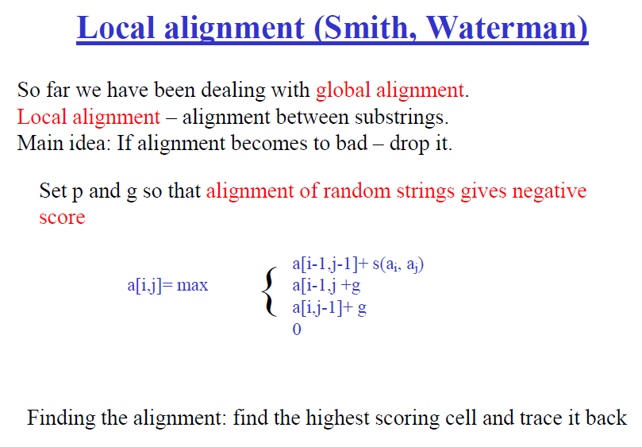

Slide 38
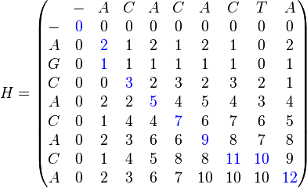
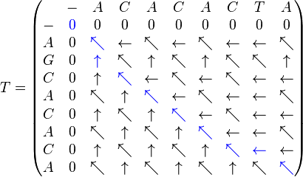
Example
Sequence 1 = ACACACTA
Sequence 2 = AGCACACA
Sequence 1 = A--CACACTA
Sequence 2 = AGCACAC--A

Slide 39
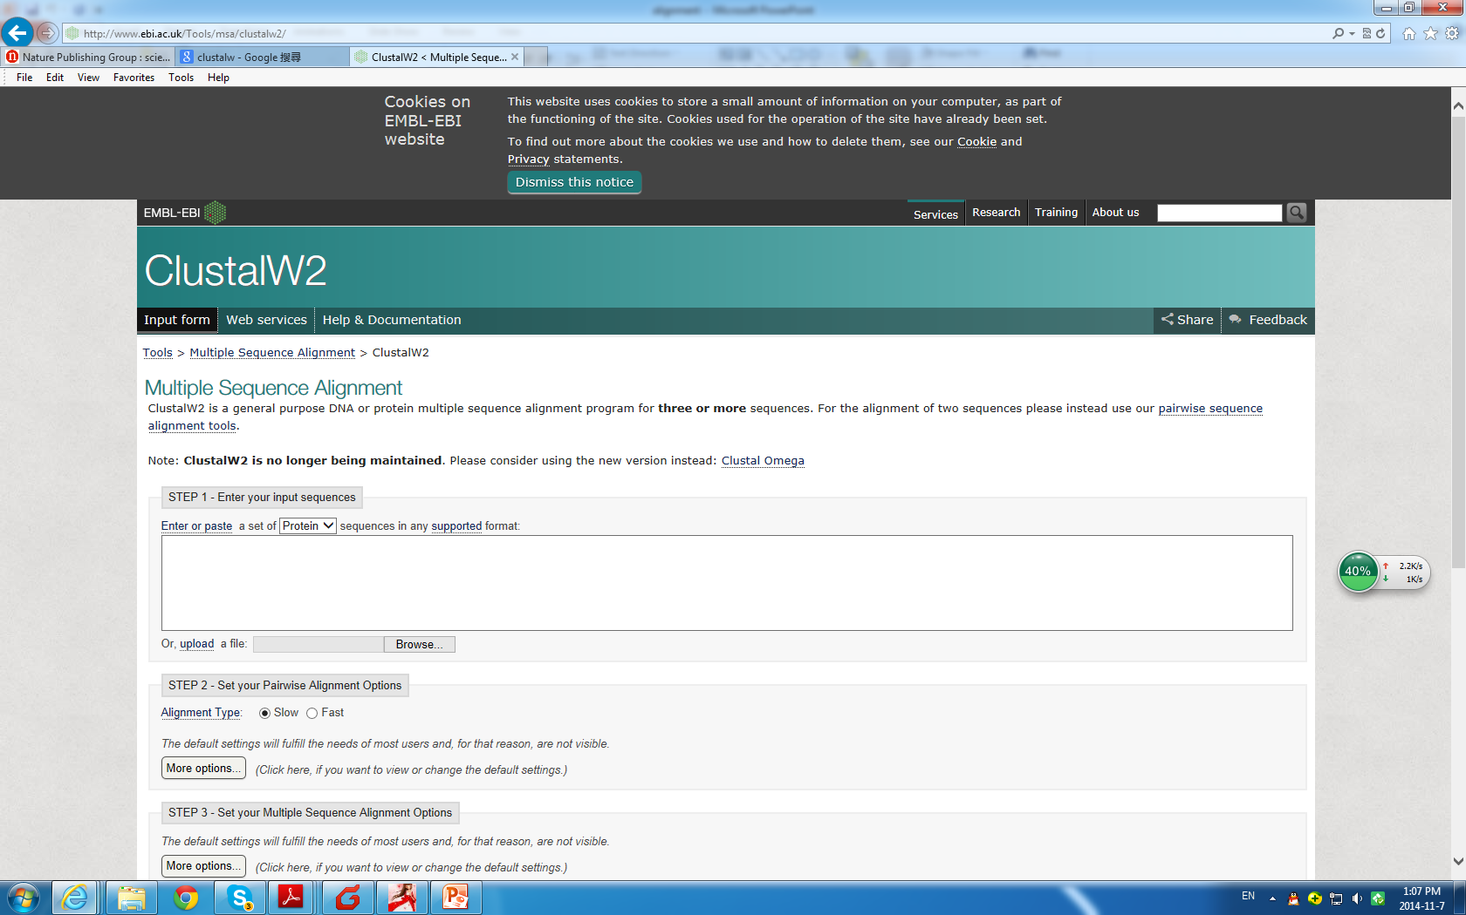
ClustalW

Slide 40
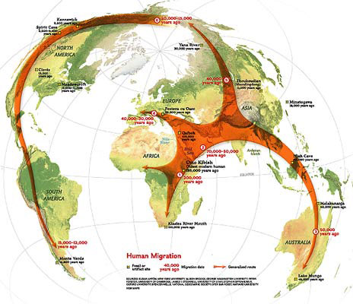
Example: out of Africa

Slide 41
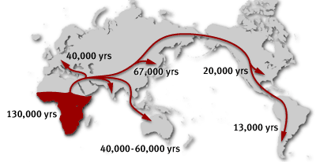
Evidence
Fossile
DNA sequence analysis

Slide 42
Homework
Insulin is a peptide hormone, produced by beta cells of the pancreas, and is central to regulating carbohydrate and fat metabolism in the body.
>gi|386828|gb|AAA59172.1| insulin [Homo sapiens]
MAWMRLLPLLALLALWGPDPAAAFVNQHLCGSHLVEALYLVCGERGFFYTPKTRREAEDLQVGQVELGGGPGAGSLQPLALEGSLQKRGIVEQCCTSICSLYQLENYCN
>gi|82749718|gb|ABB89743.1| preproinsulin 1 [Rattus losea]
MALWMRFLPLLALLVVWEPKPAQAFVKQHLCGPHLVEALYLVCGERGFFYTPKSRREVEDPQVPQLELGGSPEAGDLQTLALEVARQKRGIVDQCCTSICSLYQLENYCN
>gi|402892452|ref|XP_003909428.1| PREDICTED: insulin isoform 4 [Papio anubis]
MALWMRLLPLLALLALWGPDSVPAFVNQHLCGSHLVEALYLVCGERGFFYTPKTRREAEDPQVGQVELGGGPGAGSLQPLALEGSLQKRGIVEQCCTSICSLYQLENYCN
>gi|344307503|ref|XP_003422420.1| PREDICTED: insulin-like isoform 1 [Loxodonta africana]
MALWTRLLPLLALLAVGAPPPARAFVNQHLCGSHLVEALYLVCGERGFFYTPKTRREVEDTQVGEVELGTGLQPFPAEAPKQKRGIVEQCCTGVCSLYQLENYCN

Slide 43
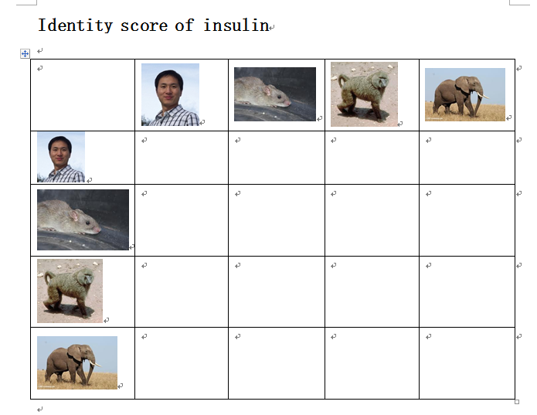

Slide 44
Demo
Write your own program, and demo in class
A .fasta file will be provided to test your program
Your program must be able to read fasta files
Score | Criteria
100 | 1, wrote a alignment program 2, demon in class 3, correctly calculate the identity score
80 | 1, wrote a alignment program 2, demon in class
0 | 1, no programming or copy other’s program

Slide 45
Extra
Write a similar program to estimate the similarity of two articles.
Estimate the similarity of your program with others’ program.

